Slide 1
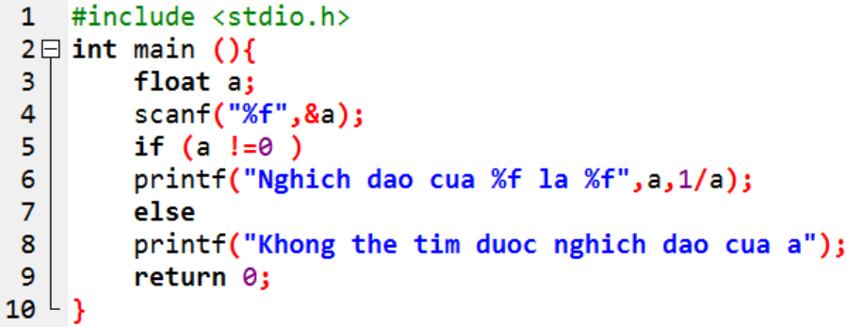
BT1.CPP

Slide 2
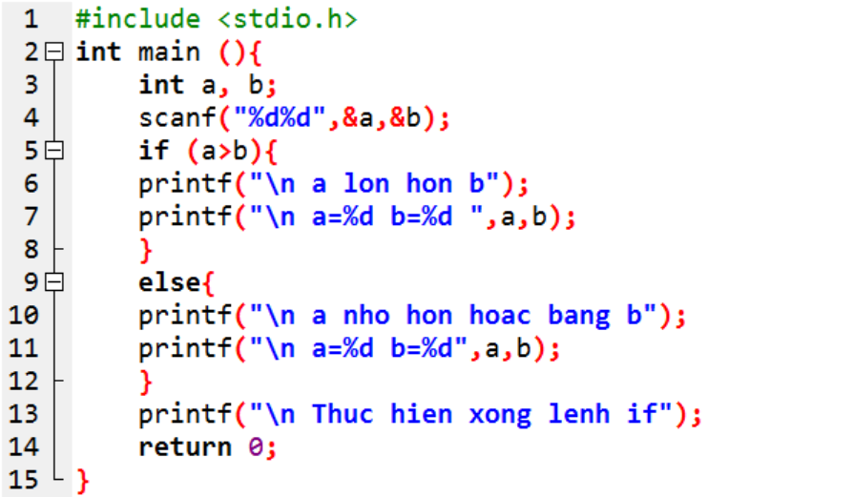
BT2.CPP

Slide 3
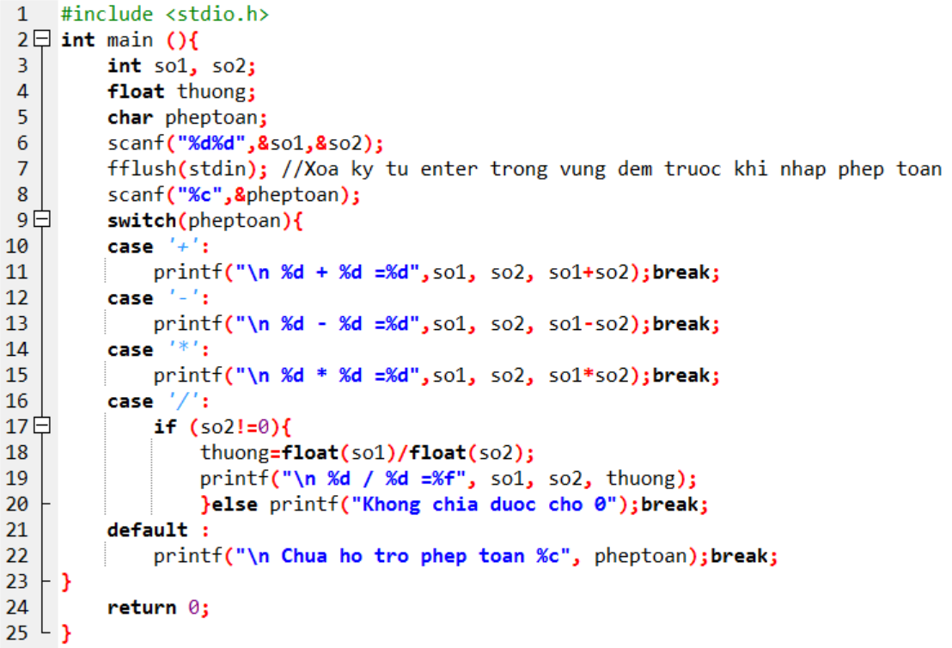
BT3.CPP

Slide 4

BT4.CPP

Slide 5
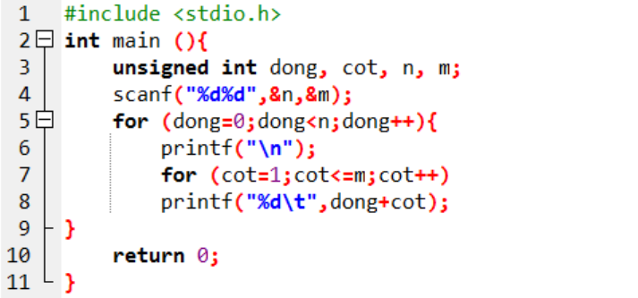
BT5.CPP

Slide 6
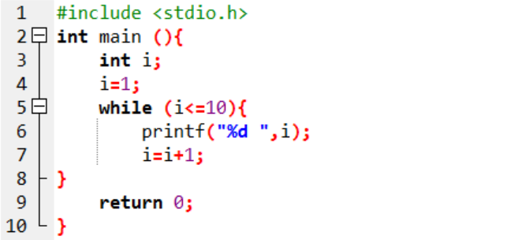
BT6.CPP

Slide 7
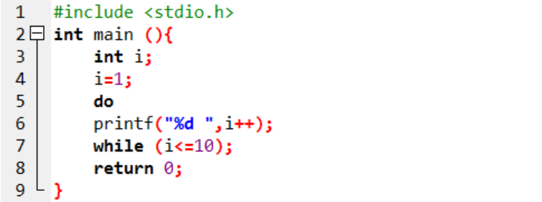
BT7.CPP

Slide 8

BT8.CPP

Slide 9
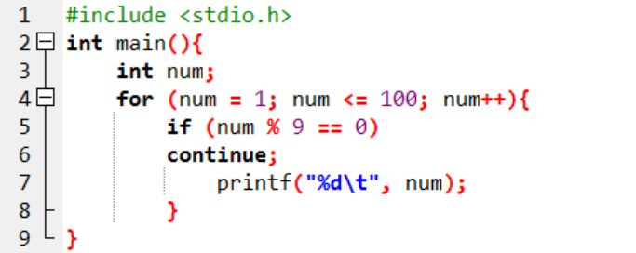
BT9.CPP

Slide 10
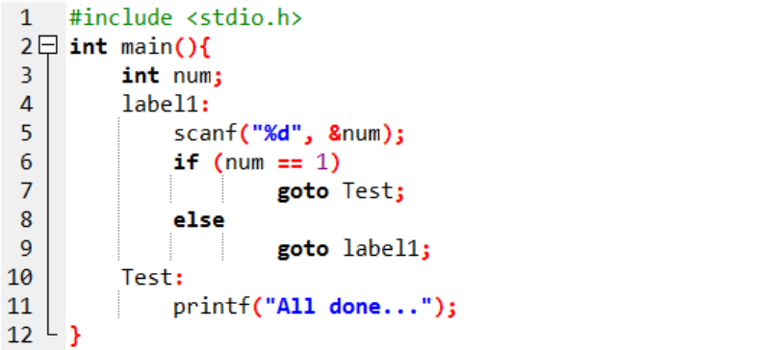
BT10.CPP

